Slide 1
Phishing Awareness Training
Presented by: EESHAH LATIF
CodeAlpha Internship

Slide 2



Understanding Phishing: The Digital Lure
What is Phishing?
Why Does it Matter?
Phishing is a type of cyber-attack where malicious actors masquerade as trusted entities to trick individuals into revealing sensitive information, such as passwords or credit card details. It's often the first step in larger cyber breaches.
Phishing attacks can lead to significant financial losses, identity theft, data breaches, and reputational damage for individuals and organisations alike. Protecting against them is crucial for maintaining digital security.

Slide 3

Spotting the Bait: Recognising Phishing Emails
Suspicious Senders
Always scrutinise the sender's email address. Look for misspellings, unusual domains, or addresses that don't match the purported sender.
Urgent or Threatening Tone
Phishing emails often create a sense of urgency, demanding immediate action to avoid negative consequences like account suspension or legal action.
Poor Grammar & Spelling
Professional organisations typically proofread their communications. Numerous errors in grammar or spelling can be a red flag.
Fake or Malicious Links
Hover over links (without clicking!) to see the actual URL. If it doesn't match the sender's legitimate website, it's likely a phishing attempt.

Slide 4
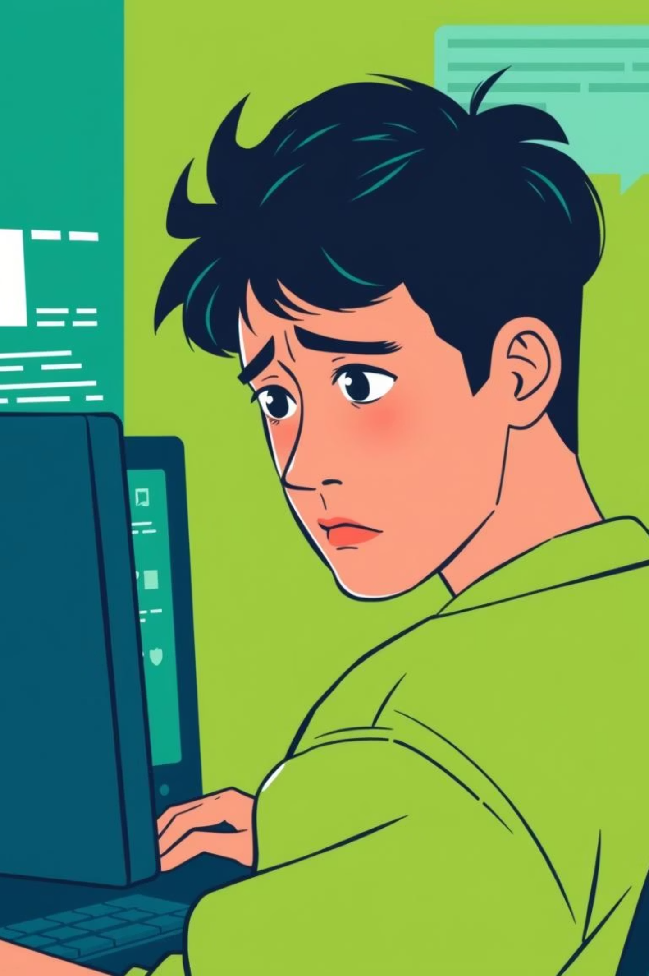
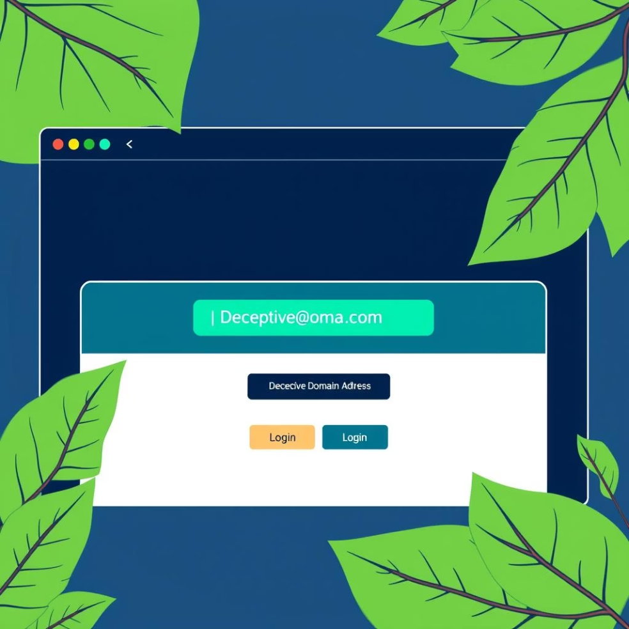
Beyond the Inbox: Fake Websites & Social Engineering
Deceptive Domains
Phishers create websites that mimic legitimate ones, using slight misspellings or alternative domains. Always check the URL in your browser's address bar carefully.
HTTPS Lock Fakes
While HTTPS indicates a secure connection, a padlock icon doesn't guarantee a website is legitimate. Phishers can obtain SSL certificates for their fake sites.
Emotional Pressure: A Hacker's Tool
Cybercriminals often exploit human emotions such as fear, urgency, curiosity, or greed to manipulate targets into taking desired actions without thinking critically.

Slide 5
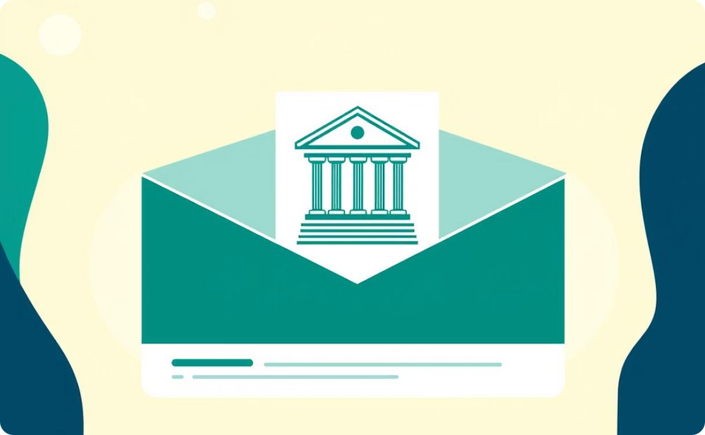
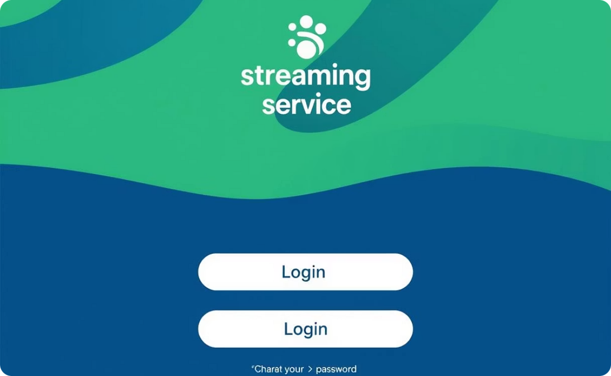
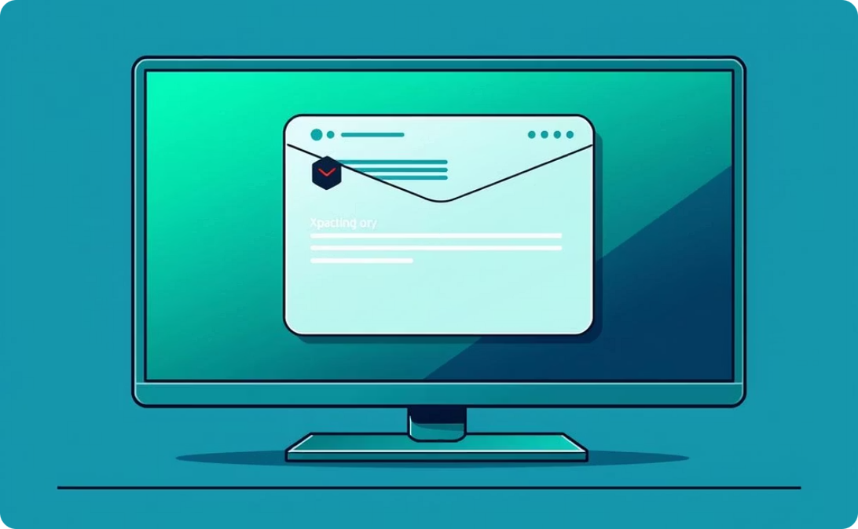
Real-World Phishing in Action
Deceptive Bank Email
Bogus Streaming Service Login
Urgent Wire Transfer Request
An email seemingly from a major bank, urging account verification due to unusual activity. The link leads to a fake login page.
A fraudulent email, often appearing to be from a CEO or senior executive, instructing an employee to initiate an urgent wire transfer.
A convincing replica of a popular streaming service's login page, designed to steal credentials when users attempt to log in.
These examples highlight the sophisticated tactics phishers employ to deceive their targets.

Slide 6
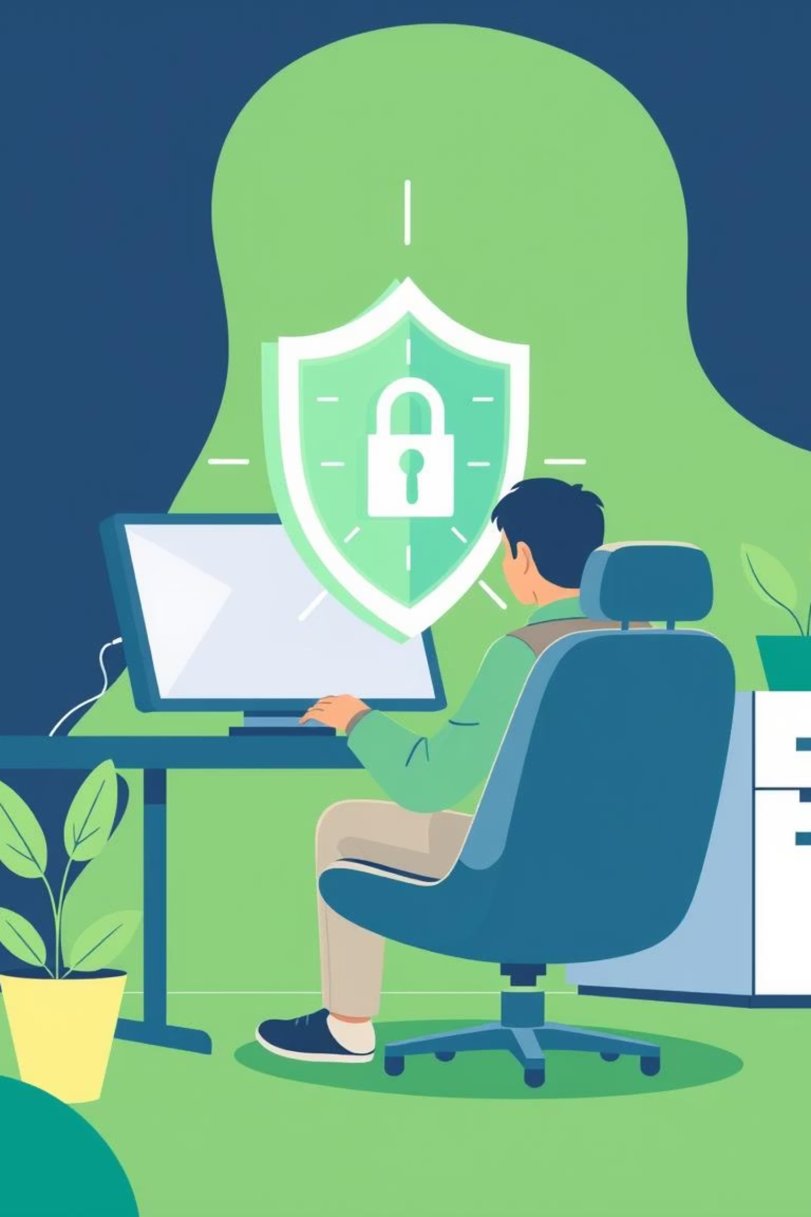




Shielding Yourself: Best Practices
Verify Sender Identity
Always double-check the sender's email address and contact them directly through a known legitimate channel if unsure.
Don't Click Unknown Links
Avoid clicking on links in suspicious emails. Instead, manually type the legitimate website address into your browser.
Enable Two-Factor Authentication (2FA)
2FA adds an extra layer of security, requiring a second verification method even if your password is compromised.
Keep Software Updated
Regularly update your operating system, web browsers, and anti-virus software to patch vulnerabilities that phishers might exploit.

Slide 7
Test Your Phishing IQ!
Engage your knowledge with these quick questions:
1
2
3
Question 1
Question 2
Question 3
You receive an email from your bank asking you to verify your account details by clicking a link. What is the best course of action?
An email from a known colleague has an attachment titled "Urgent_Invoice.zip". What should you do?
You are browsing online and notice a website address starts with "http://" instead of "https://". Should you proceed with entering sensitive information?
Click the link immediately.
Open the attachment to see the invoice.
Reply to the email asking for more information.
Yes, if the website looks legitimate.
Ask your colleague if they sent the attachment via another communication method.
No, always look for "https://" for secure transactions.
Delete the email and log in to your bank's website directly.
Only if it's a website you trust.
Forward the email to IT and delete it.

Slide 8
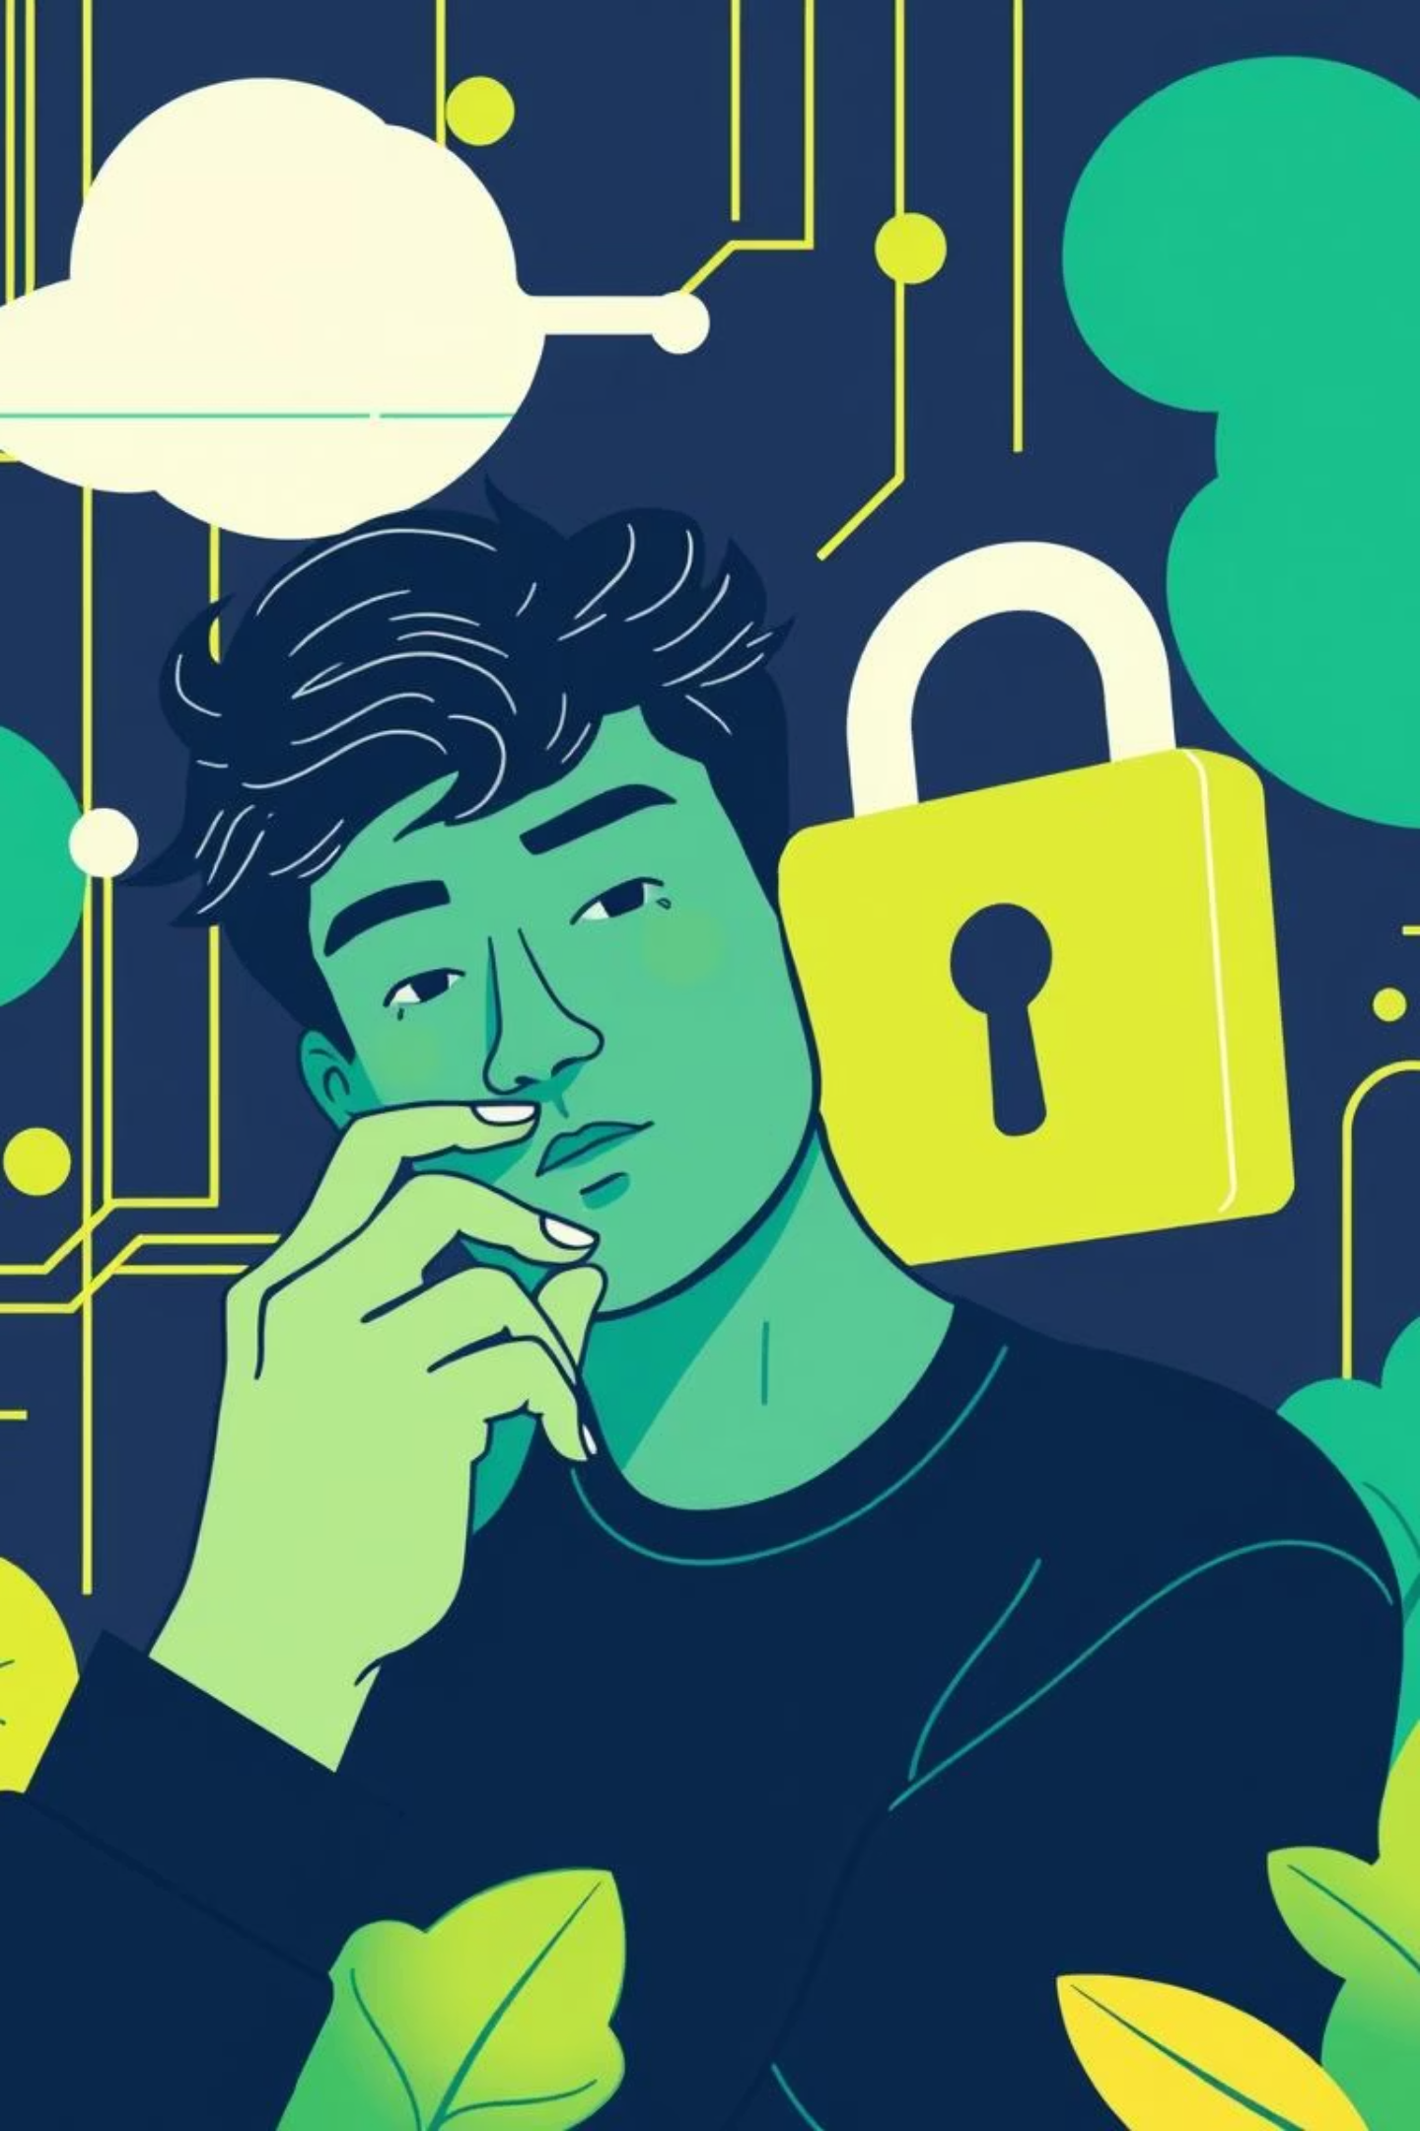

Key Takeaways: Don't Get Hooked!
Be Skeptical
Always approach unexpected emails or messages with a healthy dose of suspicion, especially if they ask for personal information.
Verify Before You Act
Cross-reference information using official channels. If in doubt, contact the sender directly via a known phone number or website.
Report Suspicions
If you suspect a phishing attempt, report it to your organisation's IT security team immediately. This helps protect everyone.

Slide 9

Staying Ahead of Evolving Threats
The landscape of phishing is constantly changing. New techniques emerge regularly, making continuous learning vital.
1
New Attack Vectors
Phishers adapt to new technologies, targeting SMS (smishing) and voice calls (vishing).
2
AI-Powered Phishing
The rise of AI allows for more convincing and personalised phishing messages, harder to detect.
3
Advanced Malware
Phishing links can now lead to sophisticated malware downloads that bypass traditional defences.
4
Continuous Education
Regular training and staying informed about the latest threats are your best defence mechanisms.

Slide 10



Conclusion: Your Role in Cybersecurity
As a CodeAlpha intern, your awareness is a critical line of defence against cyber threats.
1
Collective Security
2
Personal Responsibility
3
Vigilance
Stay alert, question the unexpected, and never hesitate to report suspicious activity. You are an essential part of our defence!

